Slide 1

Questions
  What are the types of flight rules?
  When does an arriving aircraft change its altimeter setting to the local sea level pressure?
  For what reasons are flight levels allocated?
  What are the Visual Flight Rules?
  What are the Instrument Flight Rules?
  What is the use of a Flight Plan?
  What is the use of a Flight progress Strip?
  What are the contents of an “ATC clearance”?

Slide 2

General rules
Protection of persons and property
  Negligent or reckless operation of aircraft
    An aircraft shall not be operated in a negligent or reckless manner so as to endanger life or property of others.
  Minimum heights
    Except when necessary for take-off or landing, or except by permission from the appropriate authority, aircraft shall not be flown over the congested(拥挤) areas of cities, towns or settlements or over an open-air assembly of persons, unless at such a height as will permit, in the event of an emergency arising, a landing to be made without undue hazard to persons or property on the surface.

Slide 3
Why Flight Level Allocated
To reduce conflict and maintain order
Regulated with directions and flight levels
Safe, orderly, expeditious!

Slide 4



Visual Flight Rules (VFR)
Visual Meteorological Conditions (VMC)
1,500m
300m
Vis: 5 km
300m
Notes:
目视飞行（VFR）：在可见天地线、地标的天气条件下，能够判明航空器飞行状态和目视判定方位的飞行。目视飞行机长对航空器间隔、距离及安全高度负责。

Slide 5

INSTRUMENT FLIGHT RULES (IFR)
Aircraft equipment
Minimum levels
  over high terrain or in mountainous areas 600m/8km
  Elsewhere: 300 m/8km
Notes:
Rules governing the procedures for conducting instrument flight. Also a term used by pilots and controllers to indicate type of flight plan.
仪表飞行程序所需遵守的规则

Slide 6
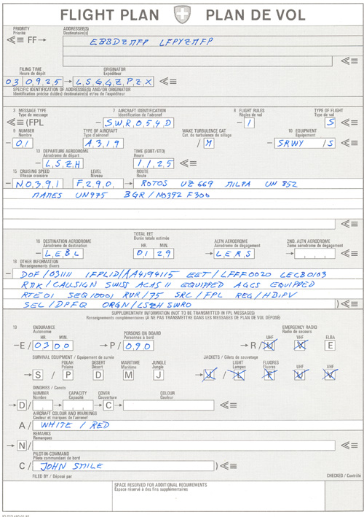
Flight Plan
Information relative to an intended flight or portion of a flight, to be provided to air traffic services units, shall be in the form of a flight plan.

Slide 7
Flight Progress Strips
Flight Plan Information is transcribed（抄写） into FPS
Clearances and instructions are recorded on them
can be arranged in a way traffic situation can be visualized.
Can help to identify traffic conflicts
080
EPL
TOU
LMG
BALAN
AMB
SW
F BFGV
<6726>
080
080
DC3 150 LFBO LFPO
150
02
10
36
10
59
10
38
11

Slide 8
Flight Progress Strips
Departure
aerodrome
Flight
levels
Call sign
080
EPL
TOU
LMG
BALAN
AMB
SW
F BFGV
<6726>
080
080
DC3 150 LFBO LFPO
150
02
10
36
10
59
10
38
11
Aircraft
type
Airspeed
Arrival
Route &
estimated time

Slide 9
Contents of ATC Clearance
aircraft identification;
clearance limit, normally destination aerodrome;
designator of the assigned SID, if applicable;
initial level, except when this element is included in the SID description;
allocated SSR code;
any other necessary instructions or information not contained in the SID description, e.g. instructions relating to change of frequency.

Slide 10

An Example of ATC Clearance
Air China 101 is cleared to Hongkong via IKENU 01, flight planned route, initial level 3600 m standard, request level change en-route, squawk 3523, after departure contact approach 124.3.

